Slide 1
The Napkin Problem
Joe & Sam

Slide 2
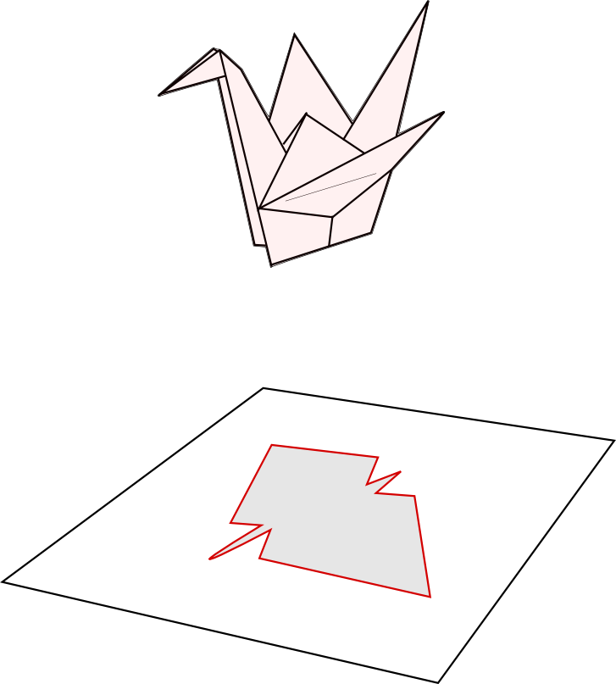
The Napkin Problem:
Definition: the maximum perimeter of an origami model is the largest perimeter you can measure by projecting your model onto the plane in any direction.

Slide 3
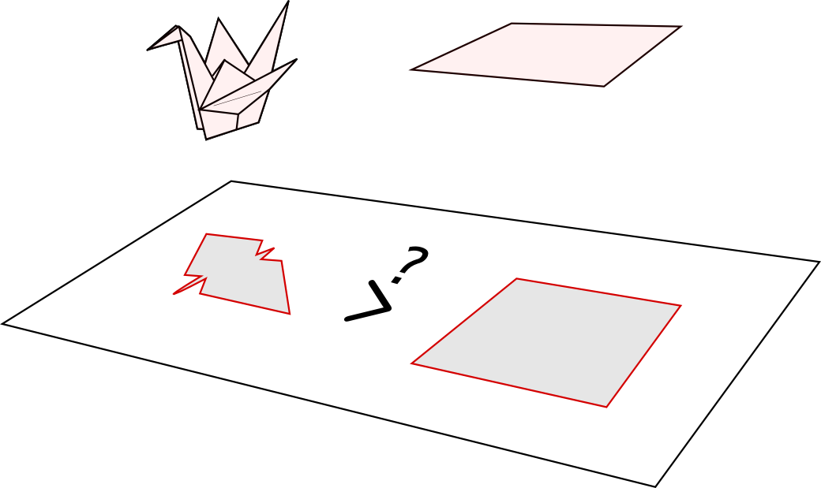
The Napkin Problem:
Definition: the maximum perimeter of an origami model is the largest perimeter you can measure by projecting your model onto the plane in any direction.
The Napkin Problem: Can you fold a square of paper into an origami model that has a maximum perimeter larger than the original square? If so, how much larger?

Slide 4
The Napkin Problem:
The Napkin Problem: Can you fold a square of paper into an origami model that has a maximum perimeter larger than the original square? If so, how much larger?
Answer:
Yes, and as large as we want!

Slide 5
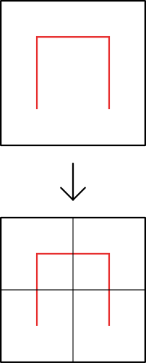
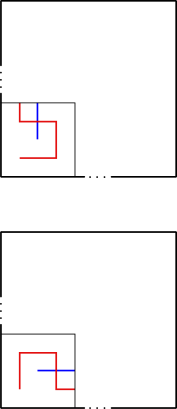
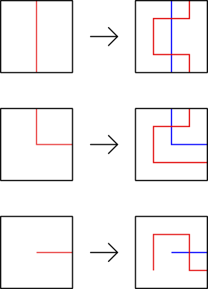
Hilbert Curves: Recipe
Key: — Previous Curve, — New Curve
Step 1: Divide each grid square into fourths
Step 2: Add the correct tile to the bottom-left.
Step 3: Fill the rest of the grid with the correct tile
- or -

Slide 6
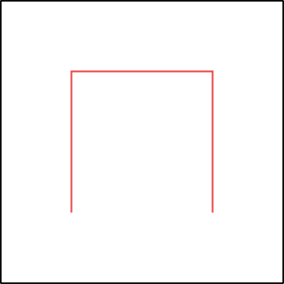
Hilbert Curves: Practice
?
H₁
H₂

Slide 7
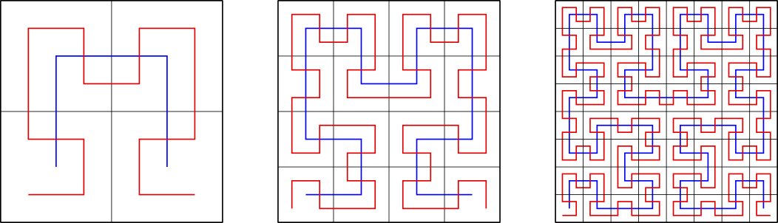
Hilbert Curves:
H₁ with H₂
H₂ with H₃
H₃ with H₄

Slide 8
Hilbert Curves:
l (old) = 1
l (new) = 2
l (old) = 1
l (new) = 2
l (old) = 0.5
l (new) = 1.75
Conclusion: l (H_{n+1}) ≥ 2l (H_{n})

Slide 9
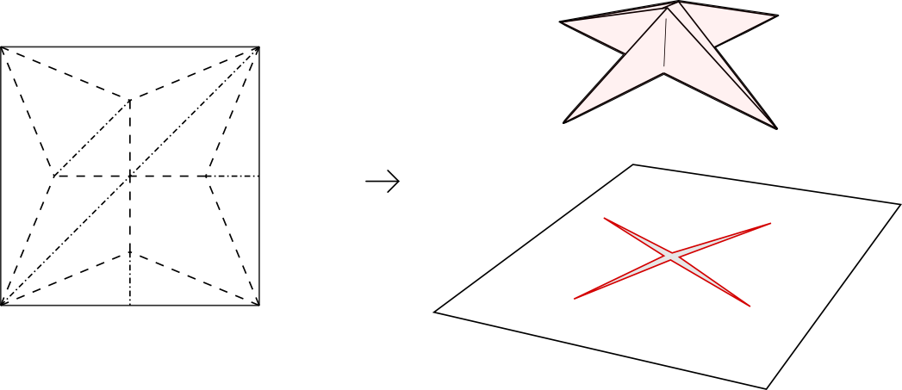
A Sequence of Origami Models
M₁

Slide 10
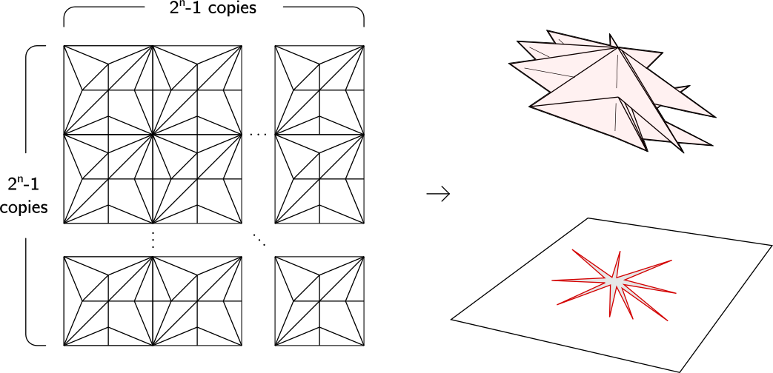
A Sequence of Origami Models
M_{n}

Slide 11
The Proof:
The length of the maximum perimeter of M_{n} is ≥ l (H_{n})
The sequence of l (H_{n})s is unbounded, so neither is the sequence of maximum perimeters of M_{n}.
We need to show this.

Slide 12
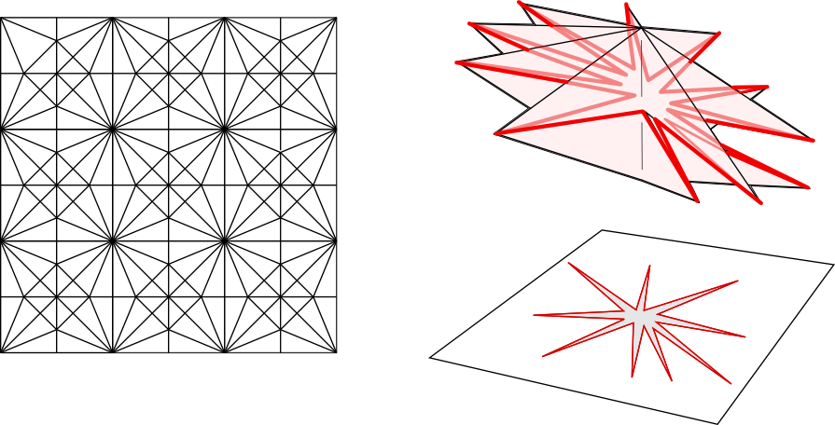
The Proof: Identifying the Perimeter
M₃

Slide 13
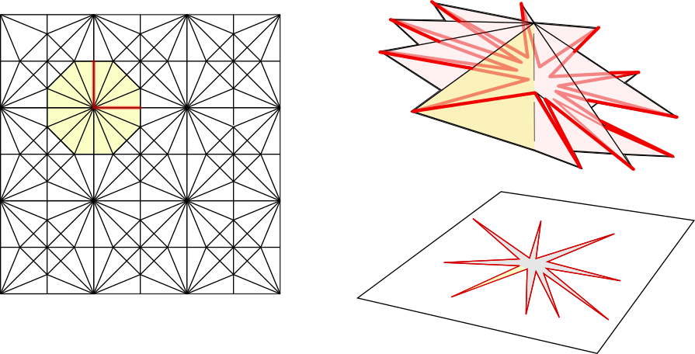
The Proof: Identifying the Perimeter
M₃

Slide 14
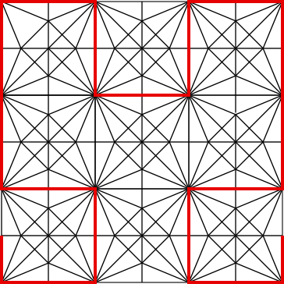
The Proof: Covering H_{n}
M₃ covers H₃

